Slide 1
POWER SYSTEM FAULT DETECTION AND CLASSIFICATION
CAPSTONE PROJECT
Presented By:
1. Jeya Nivin J-Sathyabama Institute of Science and Technology-B.E. Computer Science and Engineering

Slide 2
OUTLINE
Problem Statement
Proposed System/Solution
System Development Approach
Algorithm & Deployment
Result (Output Image)
Conclusion
Future Scope
References

Slide 3
PROBLEM STATEMENT
Design a machine learning model to detect and classify different types of faults in a power distribution system. Using electrical measurement data (e.g., voltage and current phasors), the model should be able to distinguish between normal operating conditions and various fault conditions (such as line-to-ground, line-to-line, or three-phase faults). The objective is to enable rapid and accurate fault identification, which is crucial for maintaining power grid stability and reliability.

Slide 4
PROPOSED SOLUTION
The proposed system uses machine learning to detect and classify faults in a power distribution system based on electrical measurement data (e.g., voltage and current phasors). It consists of the following components
Data Collection:
Acquire voltage and current phasor data under various conditions, including normal operation and different fault types (line-to-ground, line-to-line, three-phase).
Data Preprocessing:
Clean the data, handle missing values, and extract key features such as phasor magnitude, angle changes, and symmetrical components.
Machine Learning Algorithm:
  Train a supervised machine learning model (e.g., Random Forest, SVM, CNN, or LSTM) to classify the type of fault based on labeled data.
Deployment:
Deploy the model to monitor incoming data streams and provide real-time fault classification with minimal latency.
Evaluation:
Measure performance using accuracy, precision, recall, and confusion matrix. Continuously update the model with new data for improved accuracy.

Slide 5
SYSTEM APPROACH
Hardware:
  Processor: Intel i5 or higher
  RAM: 8–16 GB
Software:
  OS: Windows, Linux, or macOS
  Python 3.7+
Required Libraries
  Data Processing: numpy, pandas.
  Visualization: matplotlib, seabor.
  Machine Learning, scikit-learn, xgboost, tensorflow or keras.
  Utilities: joblib, pickle, scipy.signal.

Slide 6
ALGORITHM & DEPLOYMENT
Algorithm Selection:
  An LSTM network is selected for its ability to model time-dependent patterns in electrical phasor data, making it effective for detecting and classifying different fault types in power systems.
Data Input:
The model takes voltage and current magnitudes and angles, sequence components, timestamps, and frequency changes as input features to differentiate normal operation from faults like line-to-ground, line-to-line, and three- phase faults.
Training Process:
The model is trained on annotated historical or simulated datasets, using techniques like cross-validation and hyperparameter tuning to optimize performance and avoid overfitting.
Prediction Process:
In deployment, the model analyzes streaming sensor data in real time to identify and classify faults quickly, supporting prompt grid protection actions.

Slide 7
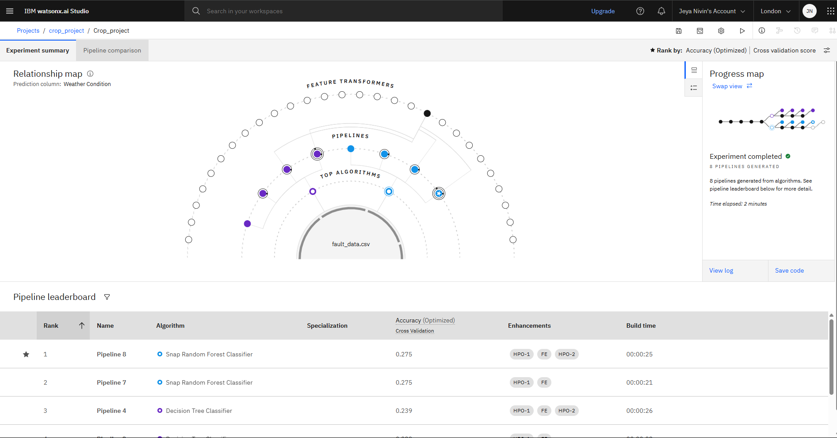
RESULT

Slide 8
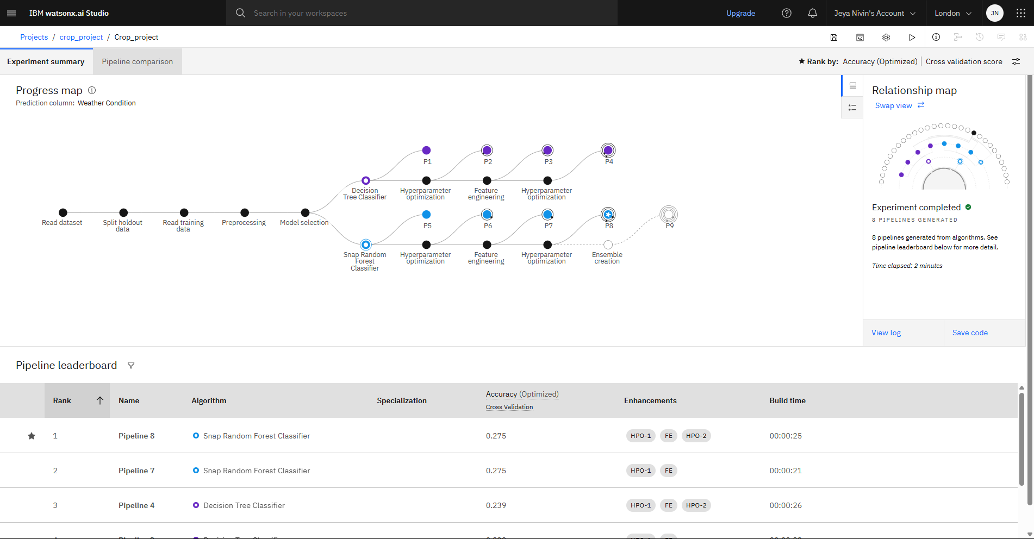
RESULT

Slide 9
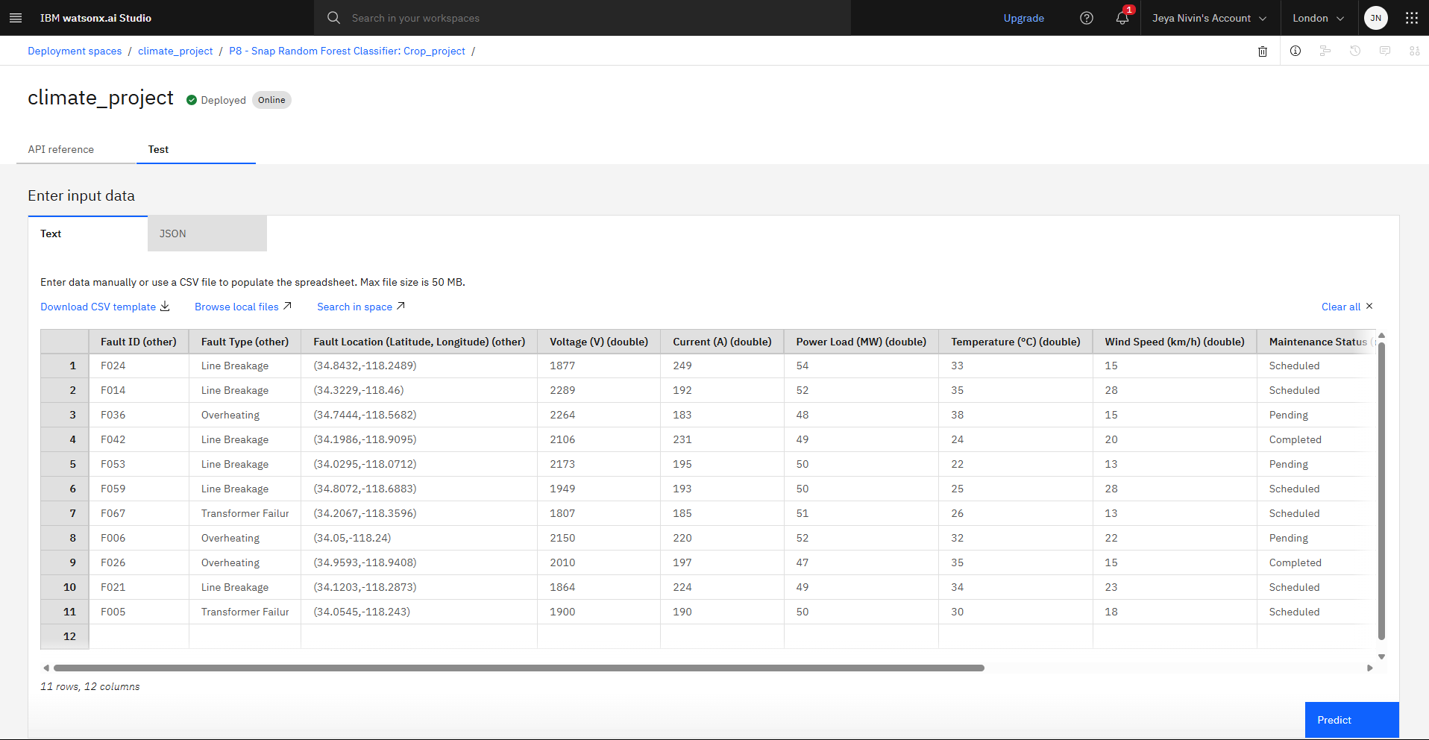
RESULT

Slide 10
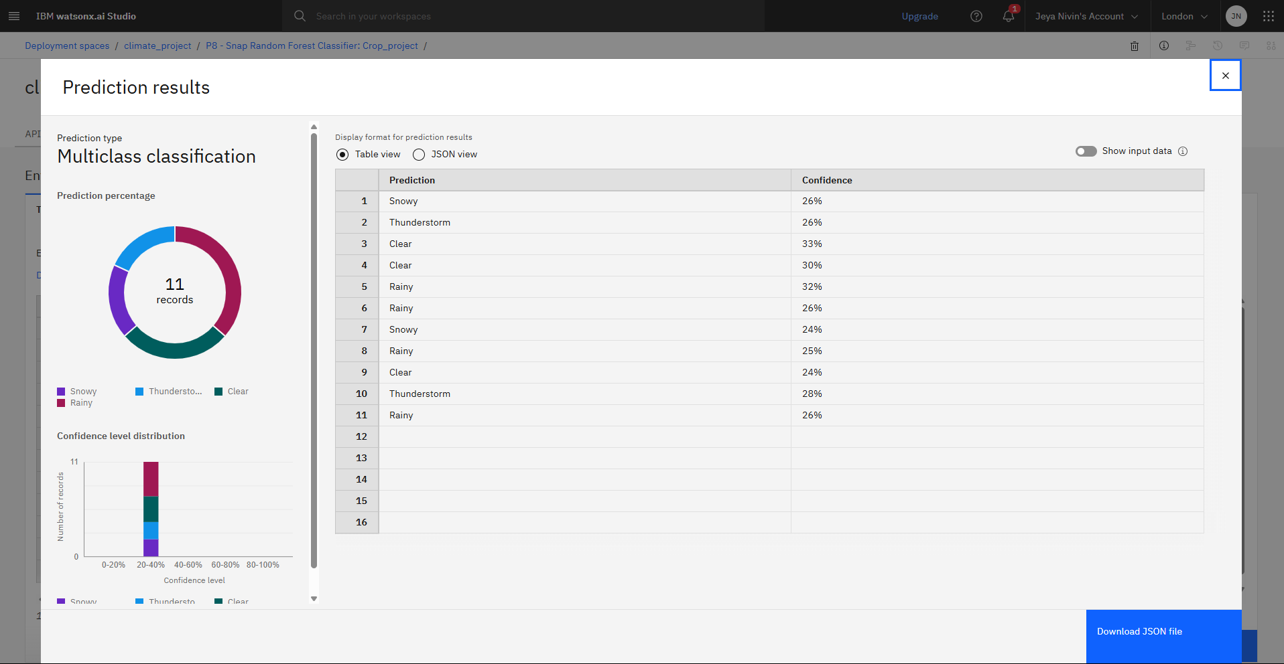
RESULT

Slide 11
CONCLUSION
The machine learning model effectively detects and classifies faults in power distribution systems using voltage and current data. It accurately distinguishes normal conditions from various faults, enabling fast and reliable fault identification to maintain grid stability.
Challenges included handling noisy data and ensuring real-time detection. Future improvements could involve better data processing and adaptive learning for enhanced accuracy.
Accurate fault detection is crucial for minimizing outages and protecting equipment, contributing to a more resilient power grid.

Slide 12
FUTURE SCOPE
The system can be improved by adding more data sources like environmental and equipment metrics to boost accuracy. Advanced algorithms such as deep learning and ensemble methods can enhance performance. Expanding the model to cover multiple regions will increase its applicability. Deploying on edge devices will enable faster, real-time fault detection. Incorporating continuous learning will help the system adapt to new fault patterns. Integration with smart grid technologies will support quicker fault isolation and recovery.

Slide 13
REFERENCES
S. Wang, J. Li, and Q. Gao (2019) presented a deep learning approach for classifying power system faults using PMU measurements in IEEE Transactions on Smart Grid.
A. Singh, S. K. Srivastava, and A. K. Sharma (2018) applied support vector machines for diagnosing faults in power distribution networks, published in Electric Power Systems Research.
H. R. Karami and S. M. F. Ghaderi (2015) utilized wavelet transforms combined with neural networks for fault detection in electrical systems, as reported in International Journal of Electrical Power & Energy Systems.
Y. LeCun, Y. Bengio, and G. Hinton (2015) reviewed foundational concepts in deep learning in their Nature article.
IBM Cloud official documentation provides guidance on deploying machine learning models on their platform (https://cloud.ibm.com/docs).

Slide 14

IBM CERTIFICATIONS

Slide 15

IBM CERTIFICATIONS

Slide 16
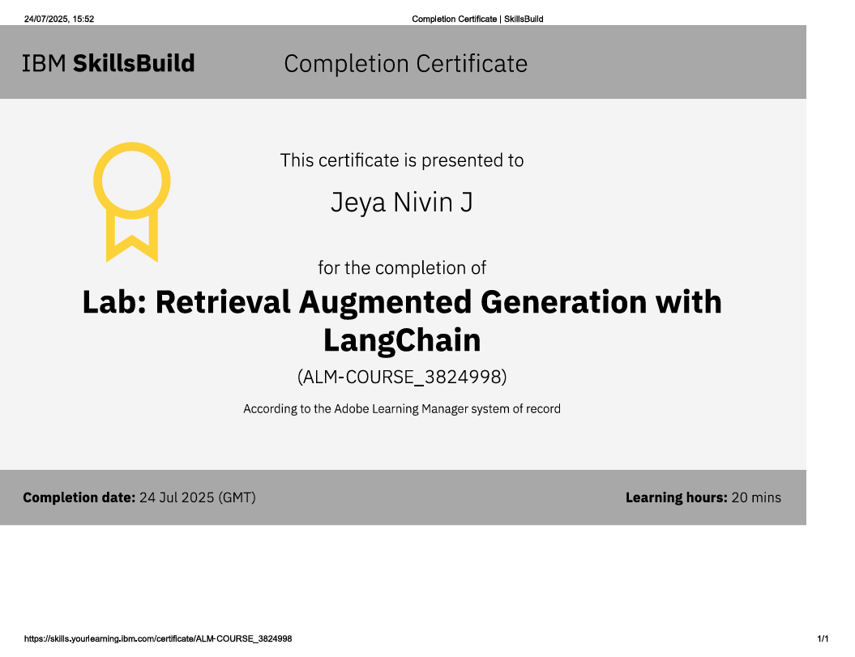
IBM CERTIFICATIONS

Slide 17
THANK YOU

